Slide 1
Data Integration
Week #01

Slide 2
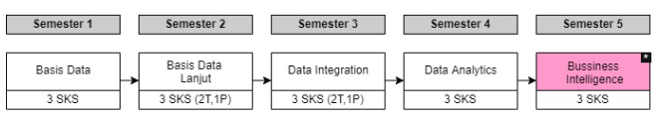

Slide 3
Review Power Designer/CDM-PDM
Week 01
Week 02 Week 03
Mempelajari Konsep Data Warehouse
Week 04
Week 05
Week 06
Power BI/Google Data Studio
Week 12
Week 13
Week 14
Week 15
Week 16 (UAS)
Pentaho
Week 07
Week 08 (UTS)
Week 09
Week 10
Week 11

Slide 4
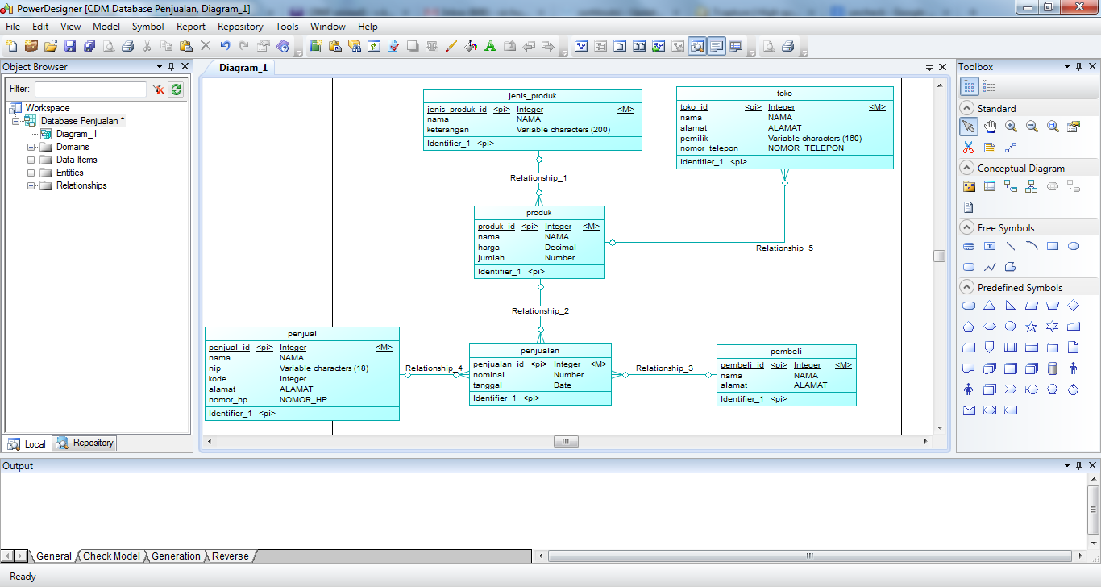

Slide 5
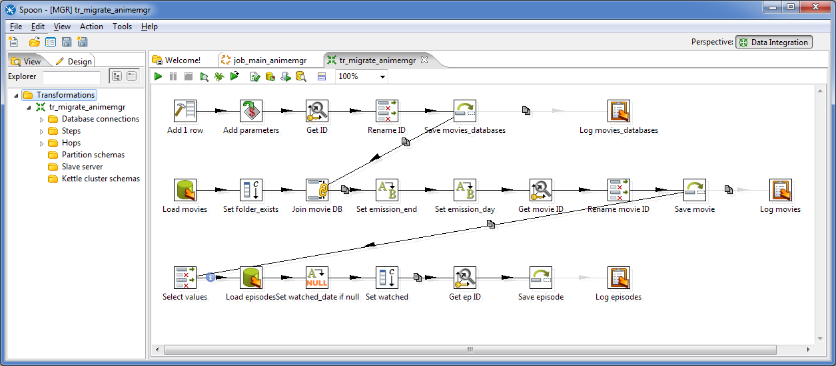

Slide 6
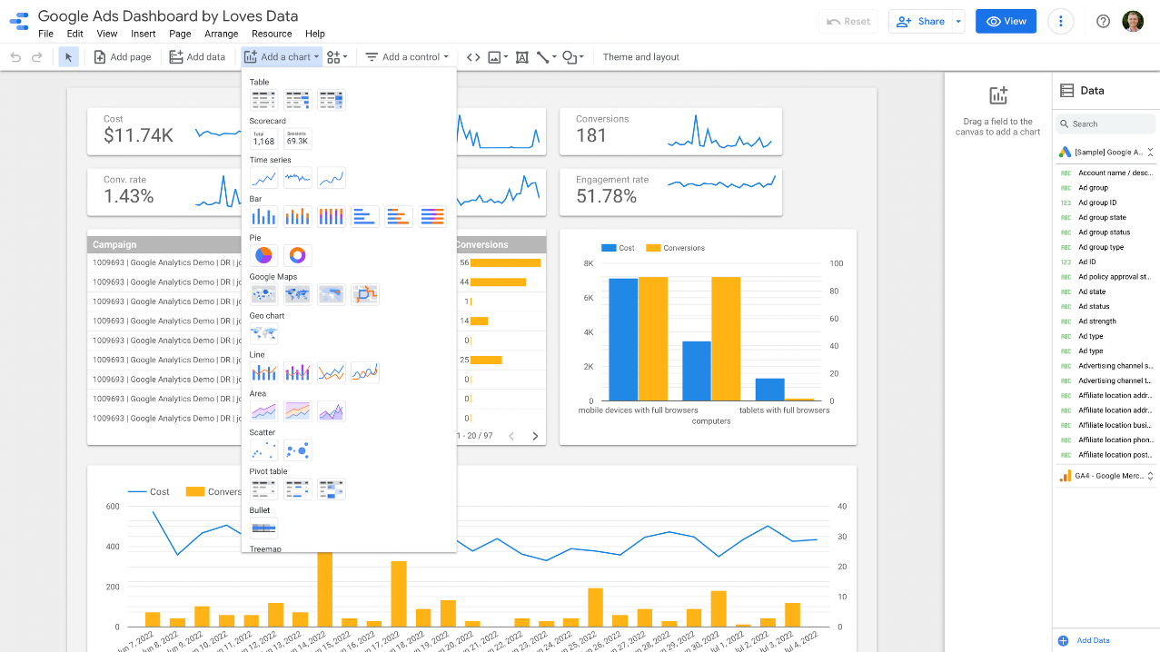

Slide 7
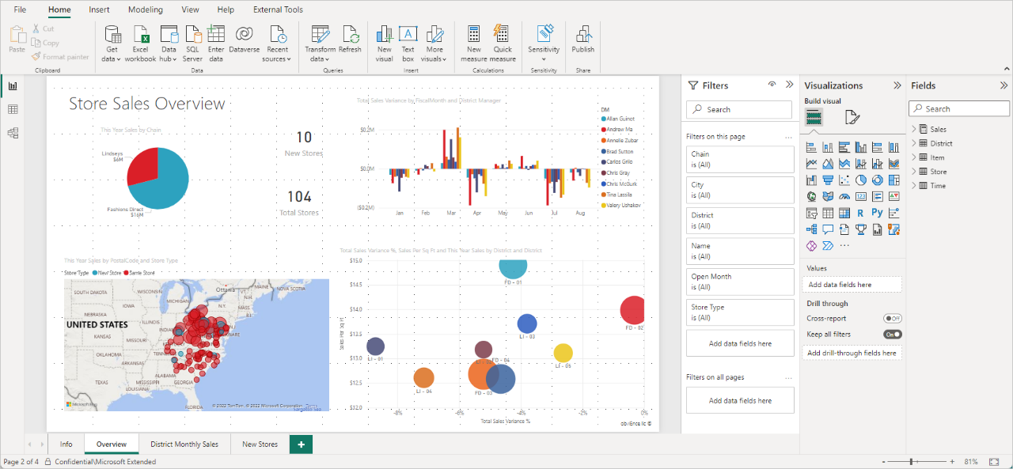

Slide 8
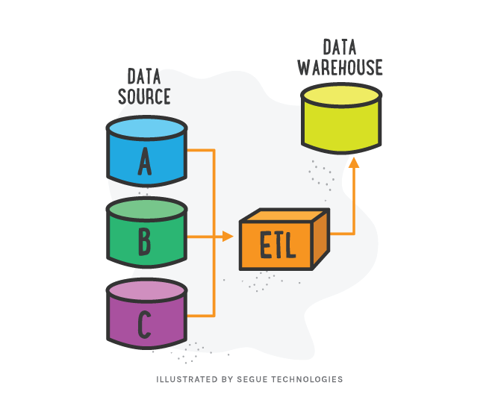

Slide 9
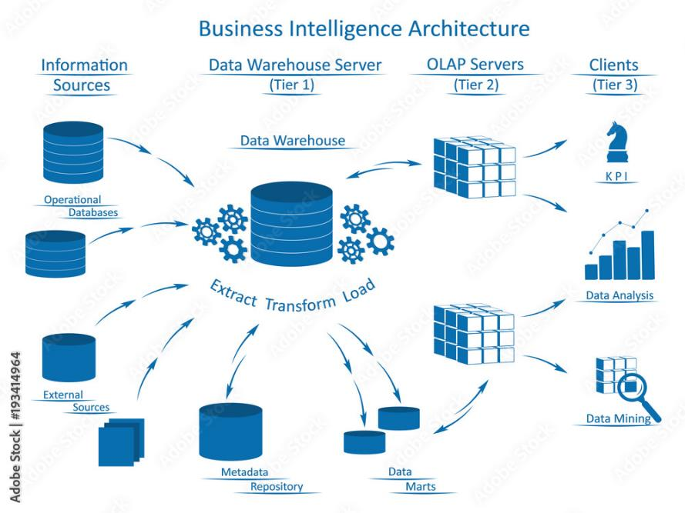

Slide 10
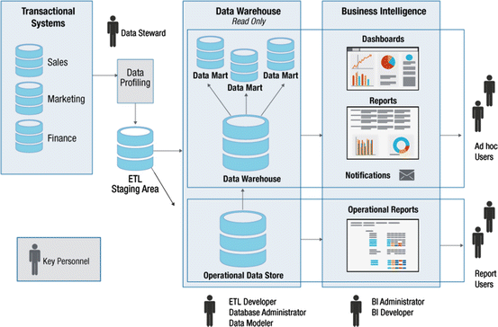

Slide 11
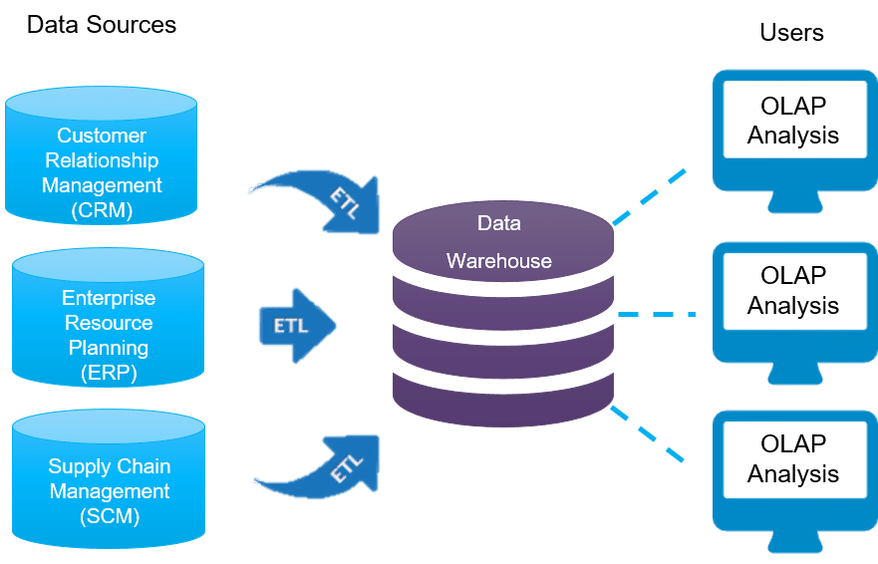

Slide 12
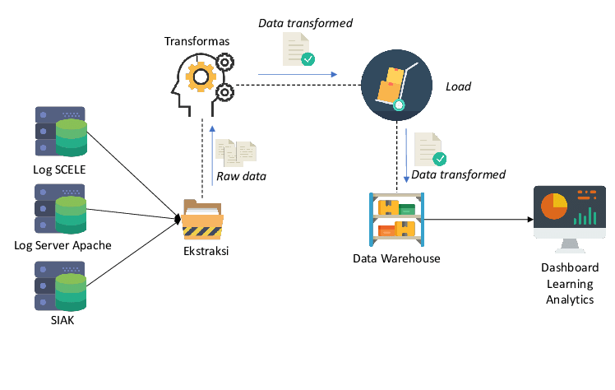
Bahan bacaan: https://aws.amazon.com/id/what-is/etl/

Slide 13
